Slide 1
“100”
“010”
“001”
cMuxEW
0 1 2
“100”
“010”
“001”
3
“10”
“01”
cMuxNS
0 1 2
EW
clock
eEW
3
3
0 1
cMuxP
NS
eNS
2
clock
3
P
clock
eP
2

Slide 2
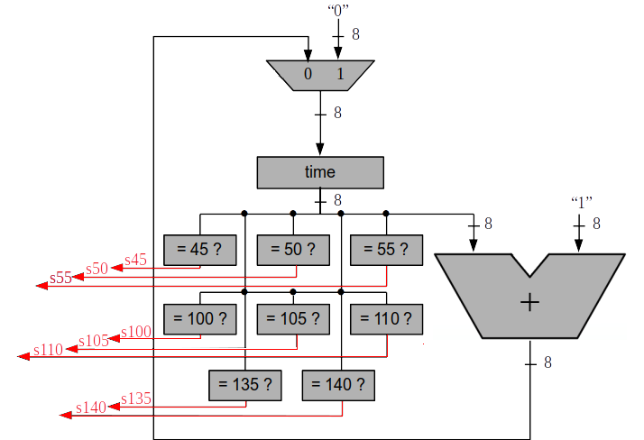
ssom
clock
ctime

